Slide 1

Comparing States: Crime Rate, Cost of Living, and Healthcare
Presented by
Sebastian Tagle
Haley Rollins
Erika Camacho

Slide 2
Questions
In light of total homicide rates, which states demonstrate a superior performance?
Considering the cost of living, which states emerge as more advantageous choices?
With regard to health care rates, which states exhibit superior outcomes?
How do the states fare when evaluating the combined metrics of total homicide rates, cost of living, and health care rates, presented side by side for comparison?

Slide 3

State-by-State Analysis of Total Homicide Rates
FBI Crime Data API: Homicides in 2021
Examine distribution of victim gender
Convert to homicides per 100,000
Notes:
In our research, we utilized data from the FBI Homicide Data API, specifically focusing on the total number of homicides reported for each state in the year 2021. Additionally, we examined the distribution of victims' gender in these homicides, capturing counts for unknown, male, and female victims. By calculating the homicide rate per 100,000 population for each state, we standardized the data, allowing for a fair and meaningful comparison of homicide rates across different states. This comprehensive analysis sheds light on the geographical disparities and provides valuable insights into the variations in homicide occurrences among states during the specified period.

Slide 4
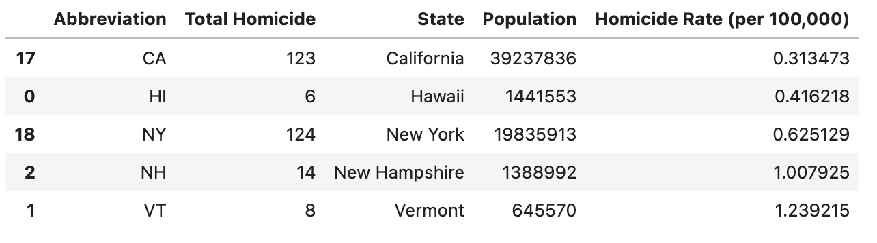
Comprehensive Tables of Total Homicides: State-wise Analysis for the Year 2021

Slide 5
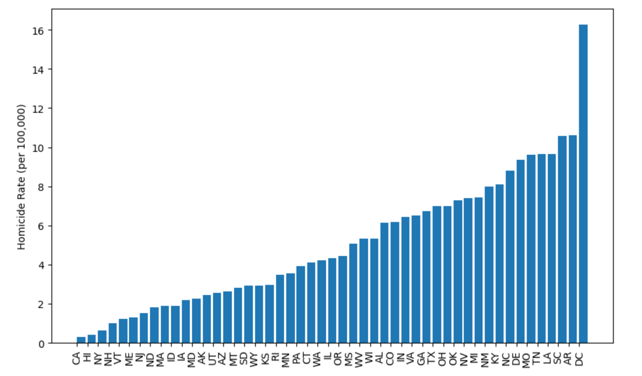
Visualizing Total Homicides: Graphical Representation of Homicide Incidents

Slide 6

Cost of Living Variation Across States
World Population Review CSV dataset
Analysis of states ranked from least to greatest based on various cost of living categories.
Housing, transportation, utility, miscellaneous and combined
Scores over 100 mean that the cost of living is above the national average
Notes:
Using a CSV dataset, we compiled a comprehensive analysis of states ranked from least to greatest based on various cost of living categories, including the cost of living index, housing expenses, miscellaneous costs, transportation charges, and utility expenses. This gathered information provides valuable insights into the varying affordability levels across different states, allowing us to discern trends and patterns in the distribution of living expenses.

Slide 7

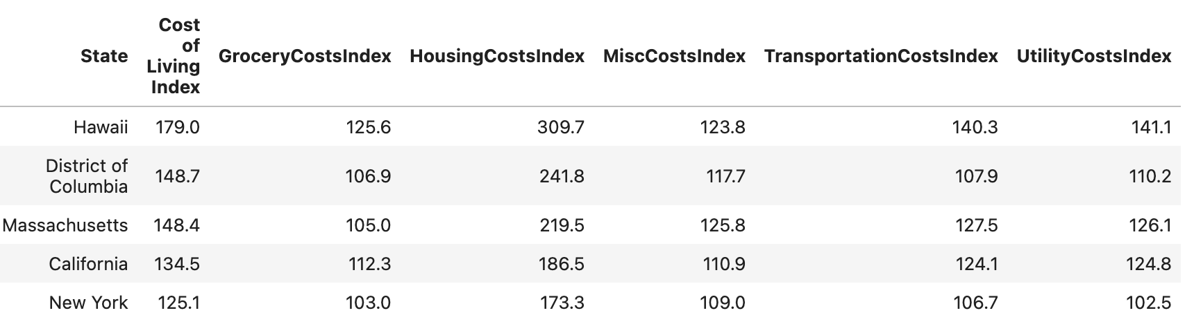
Cost of Living Index and Expenditure Breakdown: State-wise Comparison

Slide 8
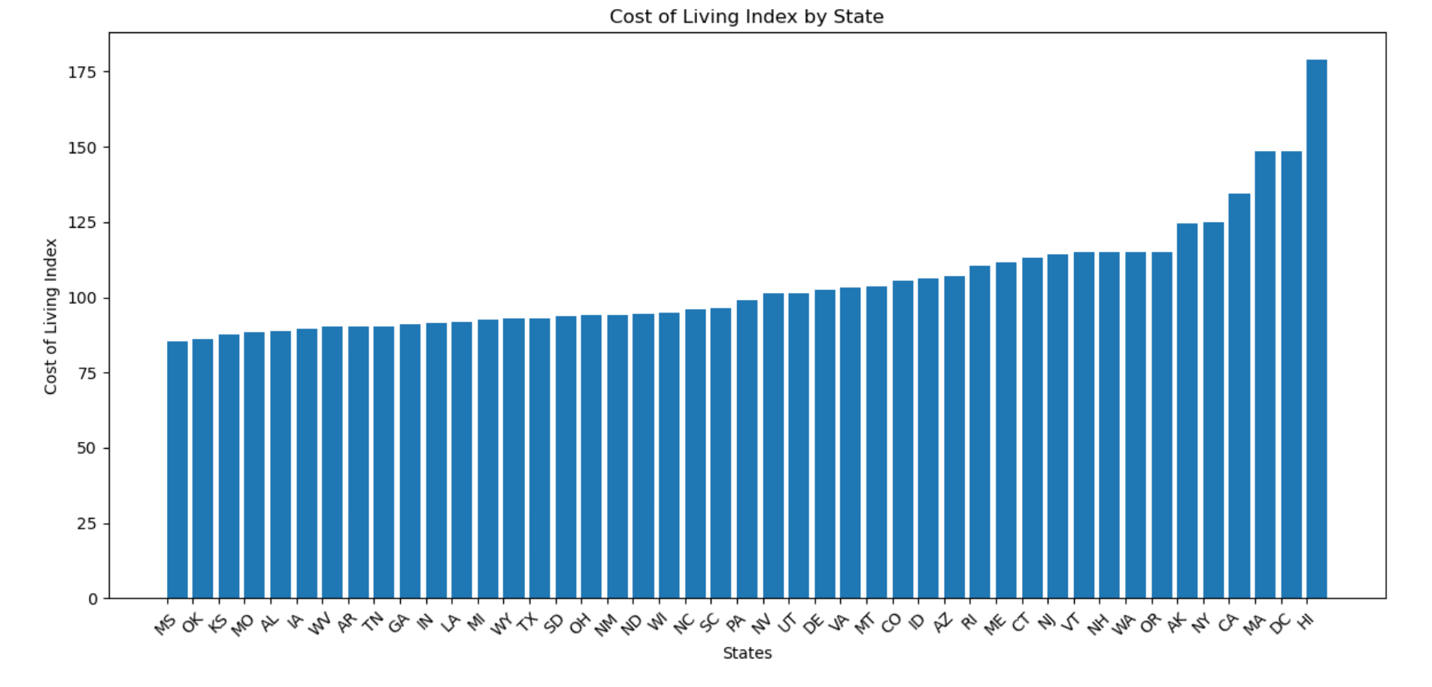
Visualizing Cost of Living: State-by-State Comparative Analysis

Slide 9

Comparative Analysis of Healthcare Rates Across States
Forbes analysis of Kaiser Family Foundation health cost data CSV dataset
Searching for best healthcare quality via ranking
Scoring system based on a 100 scale, with higher scores meaning higher costs.
Notes:
The data gathered from a CSV file provides valuable insights into the healthcare quality across different states. Through this dataset, we can effectively observe the states that exhibit the best healthcare quality, ranking them at the top, while those with lower healthcare quality are positioned at the bottom. This comparative analysis offers a comprehensive view of the variations in healthcare standards. By organizing the states based on their healthcare rates, we can gain a deeper understanding of the healthcare landscape for better overall healthcare performance.

Slide 10

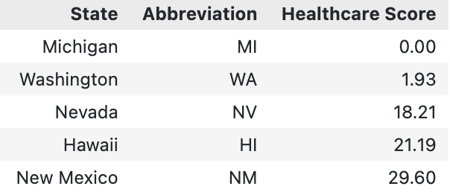
Comparative Healthcare Scores Across States

Slide 11

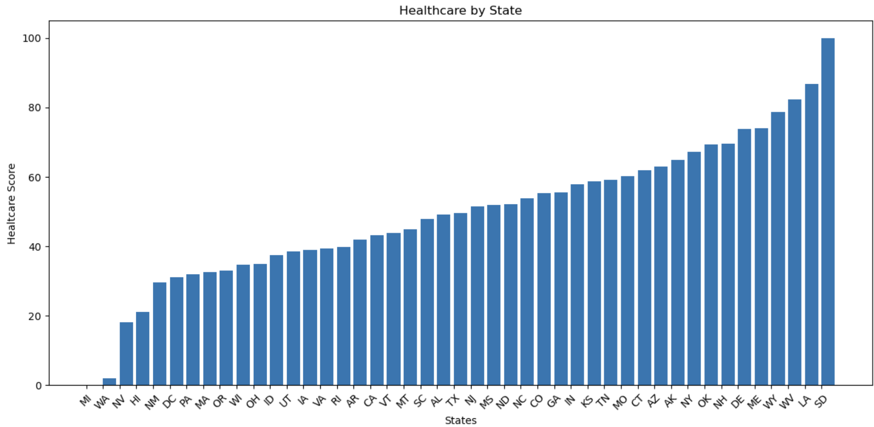
Visualizing Healthcare Scores: State-to-State Comparative Analysis

Slide 12

Side-by-Side Comparison of States: Combined Data Analysis
Combine three essential categories: homicide rates, cost of living, and healthcare scores.
This integrated analysis takes into account the safety aspect represented by homicide rates, the economic perspective encapsulated in the cost of living data, and the quality of healthcare services denoted by the healthcare scores
Notes:
To comprehensively assess the overall desirability of states, we made the decision to combine three essential categories: homicide rates, cost of living, and healthcare scores. By combing these key factors, we aimed to develop a holistic and objective approach to determine which states would emerge as more favorable choices. This integrated analysis takes into account the safety aspect represented by homicide rates, the economic perspective encapsulated in the cost of living data, and the quality of healthcare services denoted by the healthcare scores. By evaluating these categories in tandem, we can effectively identify states that offer a well-rounded environment for residents, facilitating informed decision-making and promoting a more insightful understanding of state comparisons.

Slide 13

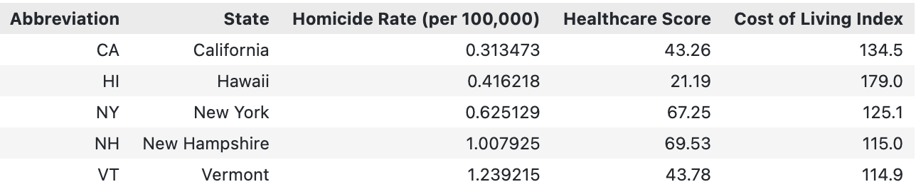
State Comparisons: Homicide, Cost of Living, and Healthcare Scores

Slide 14
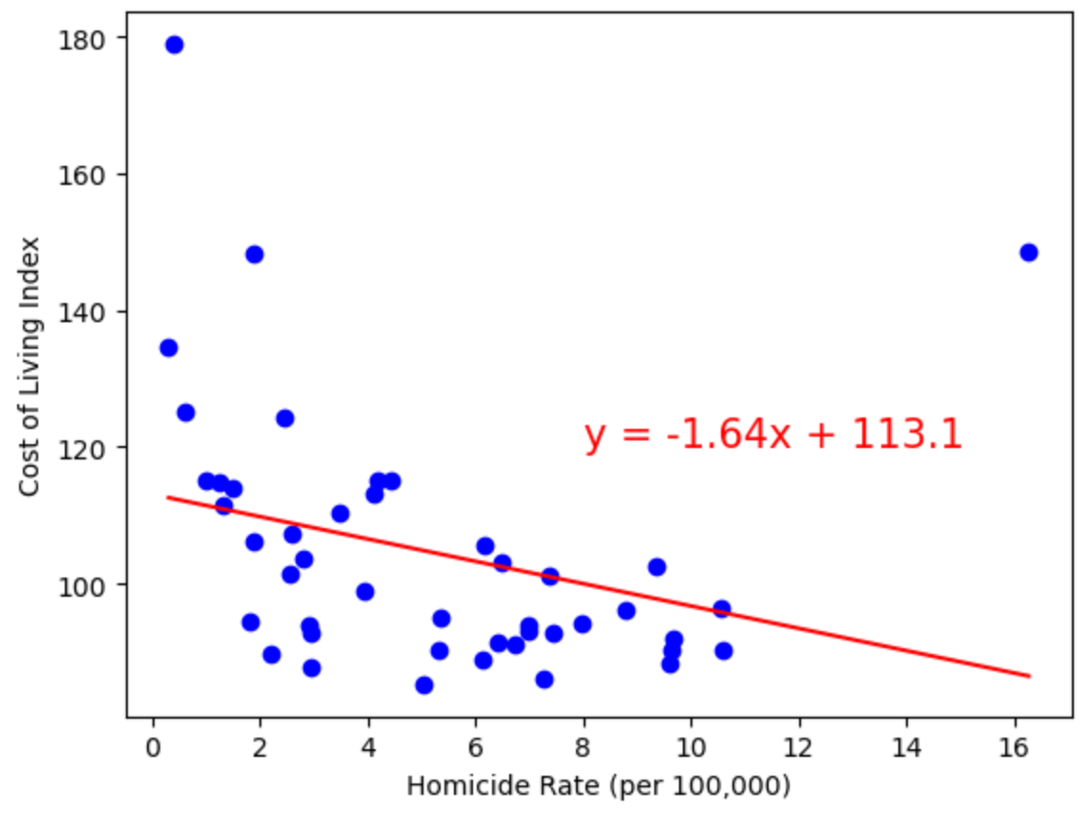
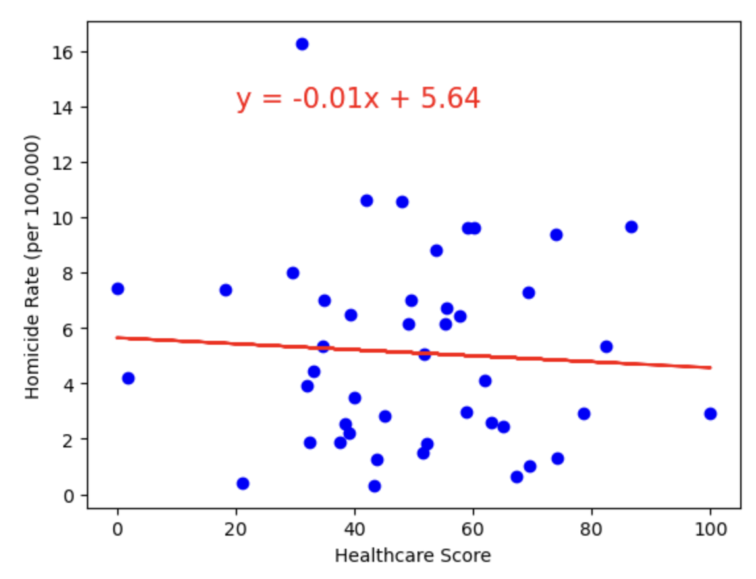
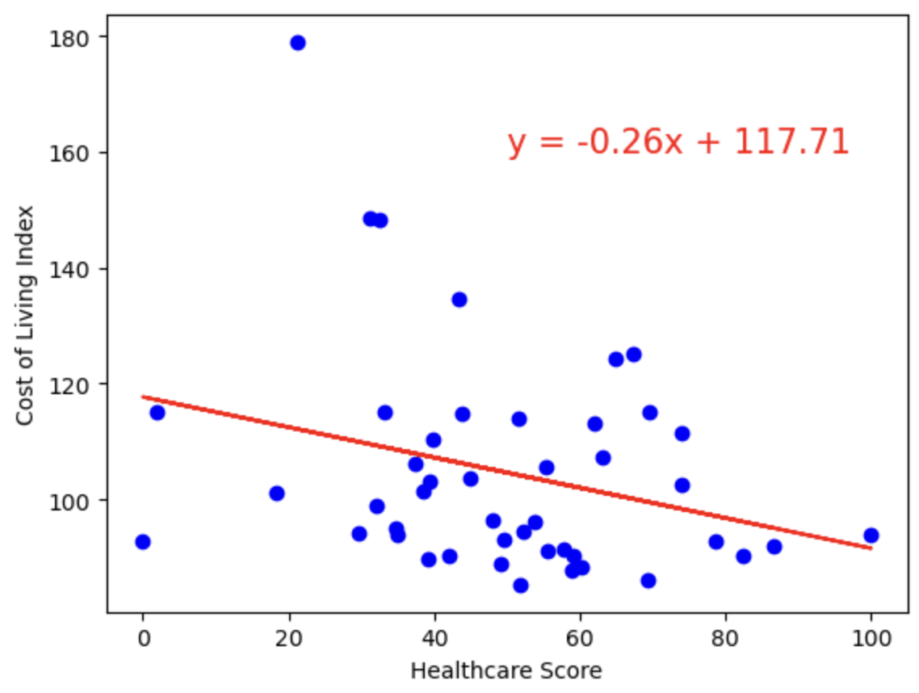
Visualizing State Comparisons: Homicide, Cost of Living, and Healthcare Scores
Cost of Living vs Homicide Rate
Correlation: -0.3
P-value: 0.046
Homicide Rate vs Healthcare Score
Correlation: .06
P-Value: 0.68
Cost of Living vs Healthcare Score
Correlation: .28
P-value: 0.06

Slide 15
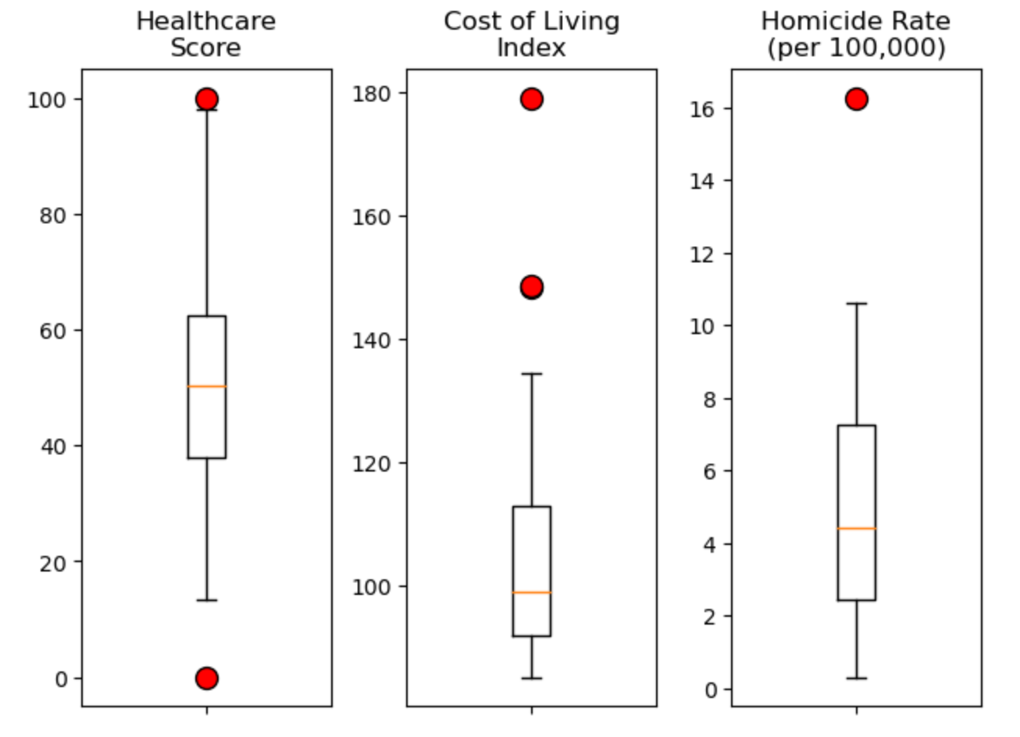
State Comparison Plots

Slide 16
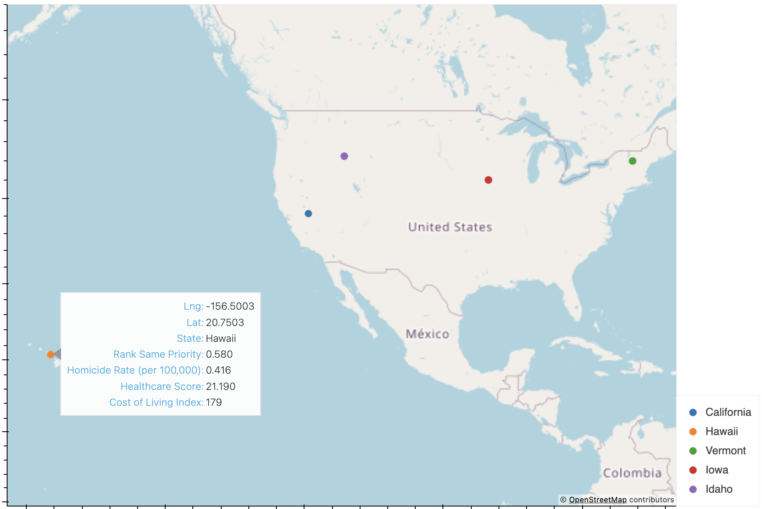
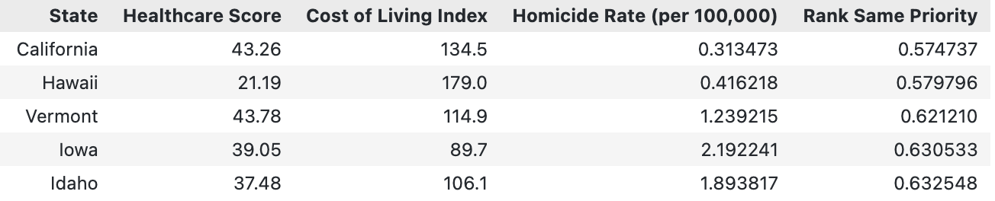
Which state is best?

Slide 17
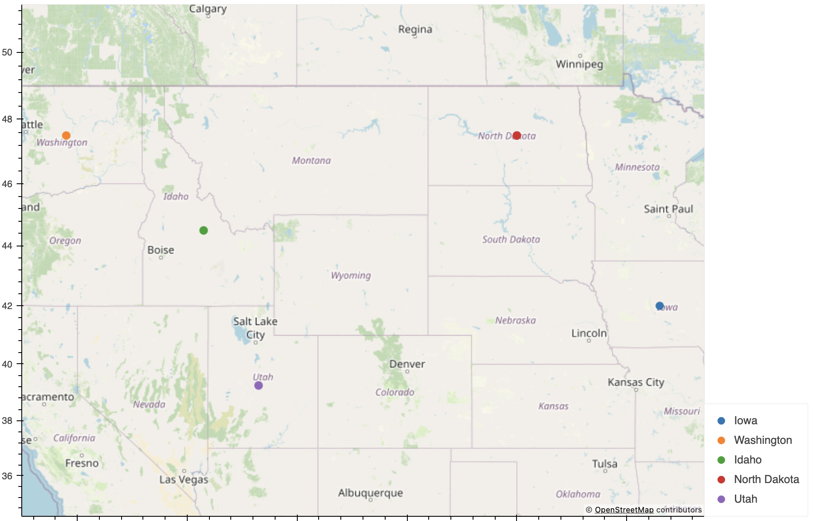
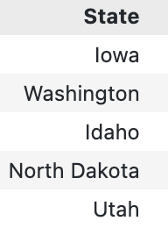
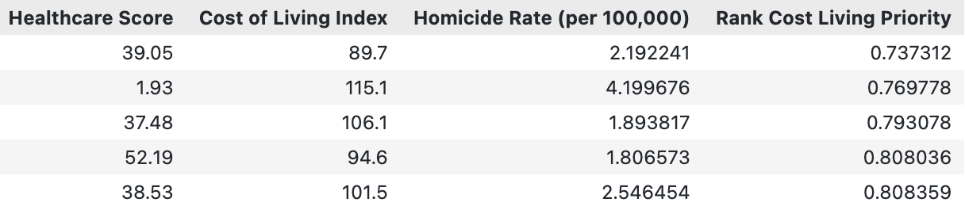
Which state is best?
Cost of living given greater weight:

Slide 18

Conclusion
The best state really depends on individual preferences
Limitations and ideas for future research:
Incomplete data
More criteria (education, employment, income per capita, etc.)
Comparison across multiple years
Notes:
In conclusion, the determination of which states are better suited for individual preferences depends on the values one places on different aspects of life. For some, a lower cost of living may be a priority, leading them to favor states that offer economic advantages. Others might prioritize safety and, thus, prioritize states with lower crime rates. Additionally, those who highly value healthcare quality may prioritize states that excel in healthcare services. This analysis has provided a comprehensive overview of the factors influencing state comparisons, allowing individuals to make informed decisions based on their unique priorities and preferences. Ultimately, the best state for one person may not be the same for another, making it essential to consider personal values when evaluating the data presented.

